Slide 1

Derivative Problem Examples Part 2
RCET 0264 Introductory Calculus
Tim Leishman

Slide 2

Derivative Problem Examples Part 2
To take the derivative of any function we can follow the following steps:
If $y=ax^{n}$ ,then $\frac{dy}{dx}=anx^{n−1}$
$y$ is $y$ and $x$ is $x$
$a$ is the number in front of $x$
$n$ is the exponent of $x$

Slide 3
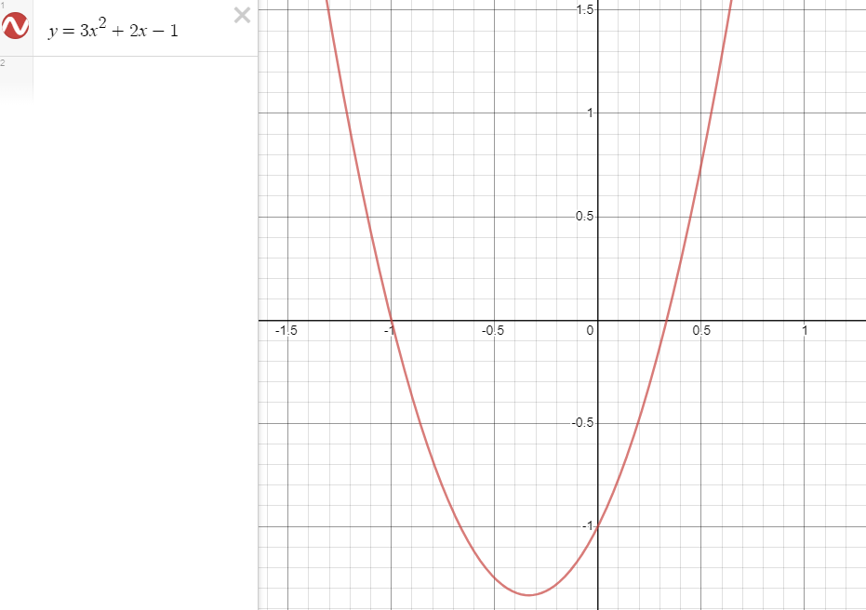
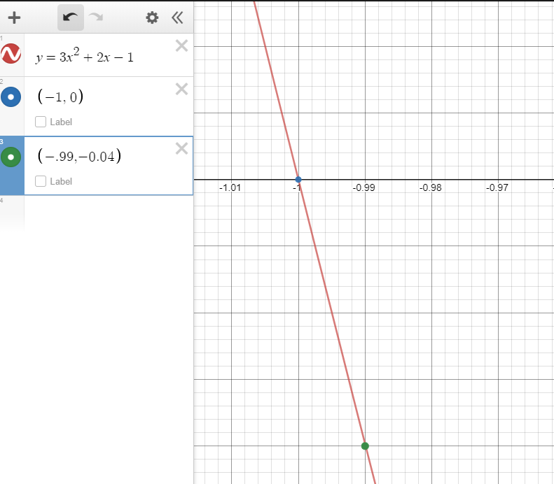

Derivative Problem Examples Part 2
If $y=ax^{n}$ ,then $\frac{dy}{dx}=anx^{n−1}$
Find $f^{′}(a)$for each function
Q$uestion 1.$
$$y=3x^{2}+2x−1 ;a=−1$$
Derivative:
$$\frac{dy}{dx}=3\left(2\right)\left(x^{\left(2−1\right)}\right)+2\left(1\right)x^{(1−1)}−1(0)(NA)$$
$$\frac{dy}{dx}=6\left(x^{1}\right)+2\left(1\right)x^{0}−0$$
$$\frac{dy}{dx}=6x+2$$
$${f^{′}}_{(−1)}=6(−1)+2$$
$${f^{′}}_{(−1)}=−6+2$$
$${f^{′}}_{(−1)}=−4$$

Slide 4
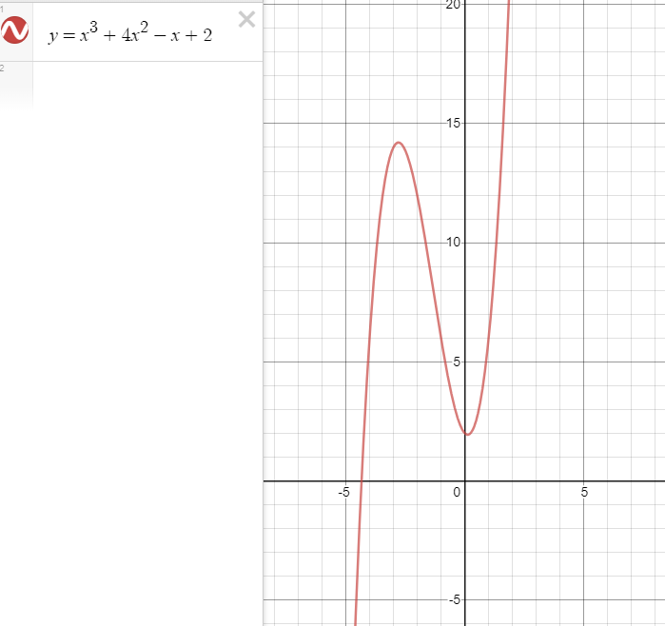
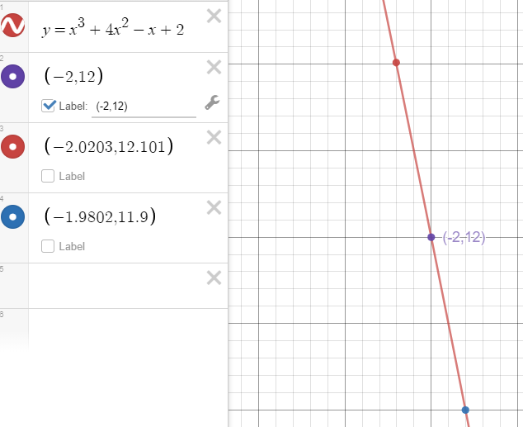
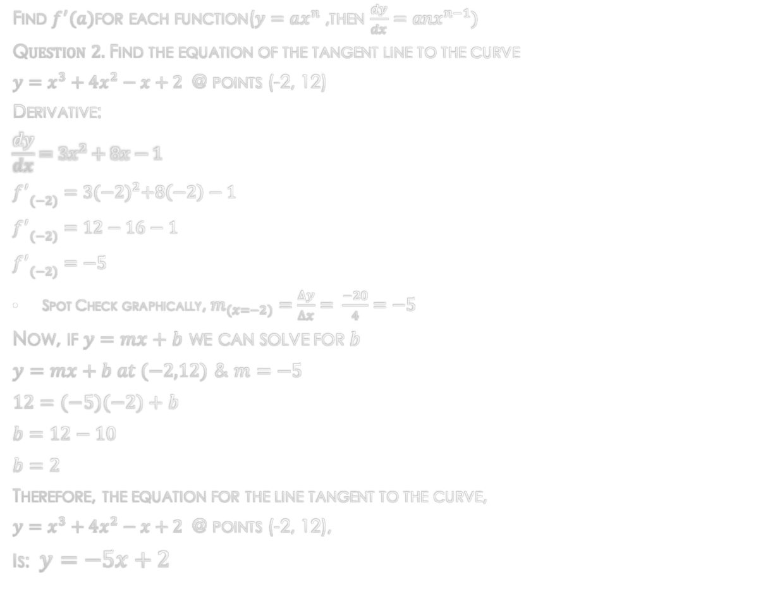
Derivative Problem Examples Part 2
Find $f^{′}(a)$for each function($y=ax^{n}$ ,then $\frac{dy}{dx}=anx^{n−1})$
Q$uestion 2.$Find the equation of the tangent line to the curve
@ points (-2, 12)
Derivative:
$$\frac{dy}{dx}=3x^{2}+8x−1$$
$${f^{′}}_{(−2)}=3{(−2)}^{2}+8\left(−2\right)−1$$
$${f^{′}}_{(−2)}=12−16−1$$
$${f^{′}}_{(−2)}=−5$$
Spot Check graphically, $m_{(x=−2)}=\frac{∆y}{∆x}= \frac{−20}{4}=−5$
Now, if $y=mx+b$ we can solve for $b$
$y=mx+b at (−2,12)$ & $m=−5$
$$12=(−5)(−2)+b$$
$$b=12−10$$
$$b=2$$
Therefore, the equation for the line tangent to the curve,
$y=x^{3}+4x^{2}−x+2$@ points (-2, 12),
Is: $y=−5x+2$

Slide 5
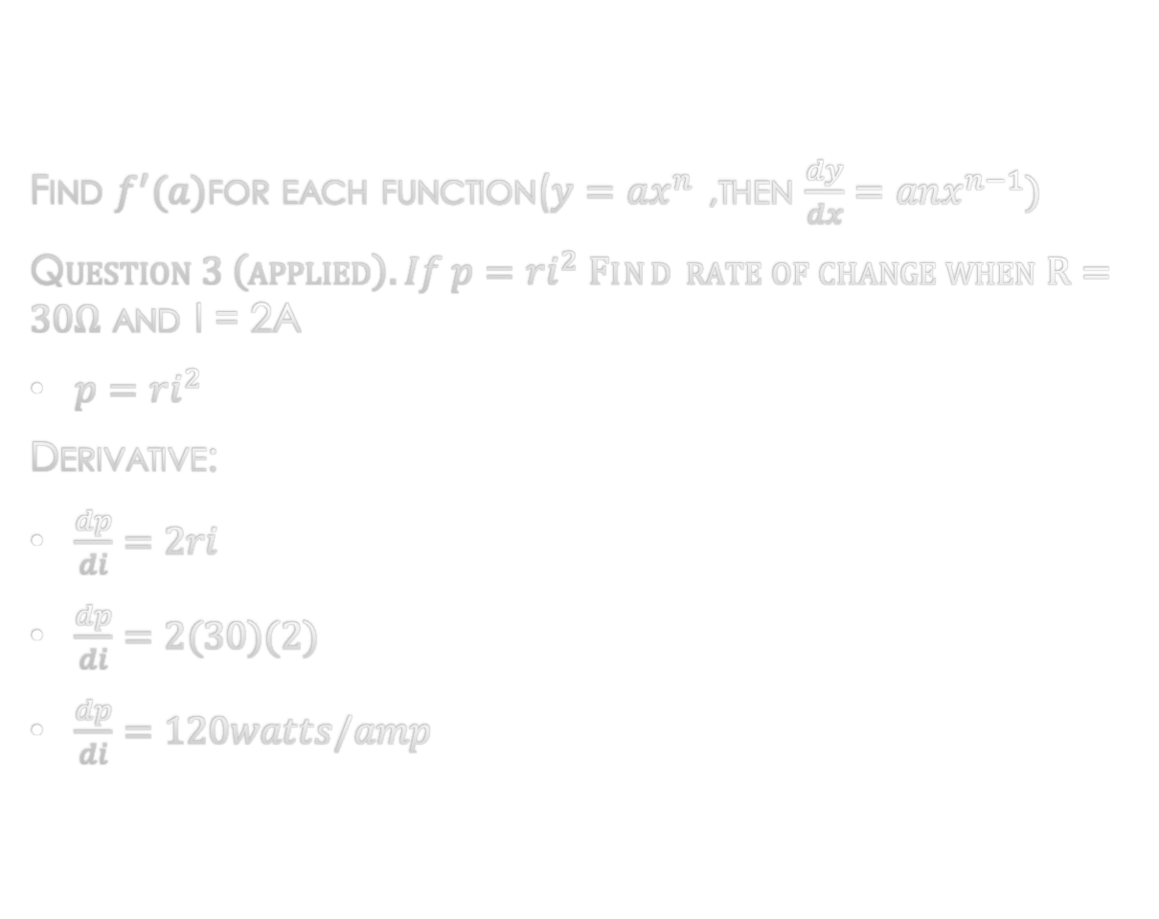
Derivative Problem Examples Part 2
Find $f^{′}(a)$for each function($y=ax^{n}$ ,then $\frac{dy}{dx}=anx^{n−1})$
Q$uestion 3 \left(applied\right). If p=ri^{2} Find rate of change when R=30Ω$ and I = 2A
$p=ri^{2}$
Derivative:
$\frac{dp}{di}=2ri$
$\frac{dp}{di}=2(30)(2)$
$\frac{dp}{di}=120watts/amp$

Slide 6
References:
Ewen, D., Gary, J. S., & Trefzger, J. E. (2005). Technical calculus. Upper Saddle River, NJ: Pearson/Prentice Hall.
Richmond, A. E., & Hecht, G. W. (1995). Calculus for electronics. New York: Glence.
https://www.desmos.com

